Slide 1
HPML Final Project · Spring 2026
SiMamba: Simpson-Style Discretization for Mamba-3 SISO Models
Reproducible negative result: Simpson-style SISO dynamics train stably, but do not beat matched trapezoid or Mamba2; decode is near parity while prefill needs fused-kernel work.
Team 26
Soumil Baldota · ssb2234
Ansen Shia · as8008
David Zhang · dwz2107
GitHub: github.com/hpmls26/simamba
Tracking: Weights & Biases project ssb2234-columbia/simamba
Artifacts: Hugging Face repos soumil1/simamba-midpoint-10m-slimpajama-500m and soumil1/mamba2-10m-slimpajama-500m
Dr. Kaoutar El Maghraoui · Columbia University · Week of May 4, 2026

Slide 2
Motivation & Problem
Goal for the project: test whether a higher-order SISO update is actually useful for small language models on constrained hardware.
Why this matters
Problem statement
• Mamba-style SSMs replace quadratic attention with linear recurrent scans.
• Their quality and stability depend on the discrete state update.
• Mamba-3 SISO makes inference attractive, but kernel design and numerical stability are coupled.
• Higher-order quadrature is plausible, but language tokens are not smooth ODE inputs.
• Implement a Mamba-3-inspired Simamba mixer with a width-3 Simpson recurrence.
• Compare it to a matched trapezoid control and Mamba2 on identical data/schedule.
• Profile prefill/decode latency, memory, throughput, and training stability on one V100.
• Report the result honestly, even if the hypothesis fails.
HPML · Spring 2026
1 / 14

Slide 3
Technical Approach — Model & Data
Controlled 10M-parameter language-model runs; same data, seed, validation spans, and training schedule across ablations.
Model
Dataset
Hardware
• Decoder-only MambaLMHeadModel
• 8 layers, d_model=160, expand=2 → d_inner=320
• 10 heads, headdim=32, d_state=64
• Seq length 128, tied embeddings
• Simamba: Simpson or matched trapezoid SISO core
• SlimPajama-627B subset
• 500M train / 50M validation tokens
• GPT-NeoX tokenizer, uint16 memmaps
• Fixed validation spans for comparability
• No-replacement training block sampling
• Single NVIDIA Tesla V100-SXM2 16GB
• Global batch 64, micro-batch 8
• AdamW + cosine LR decay
• fp32 master parameters for SSM stability
• W&B logs + checkpoint manifests
HPML · Spring 2026
2 / 14

Slide 4
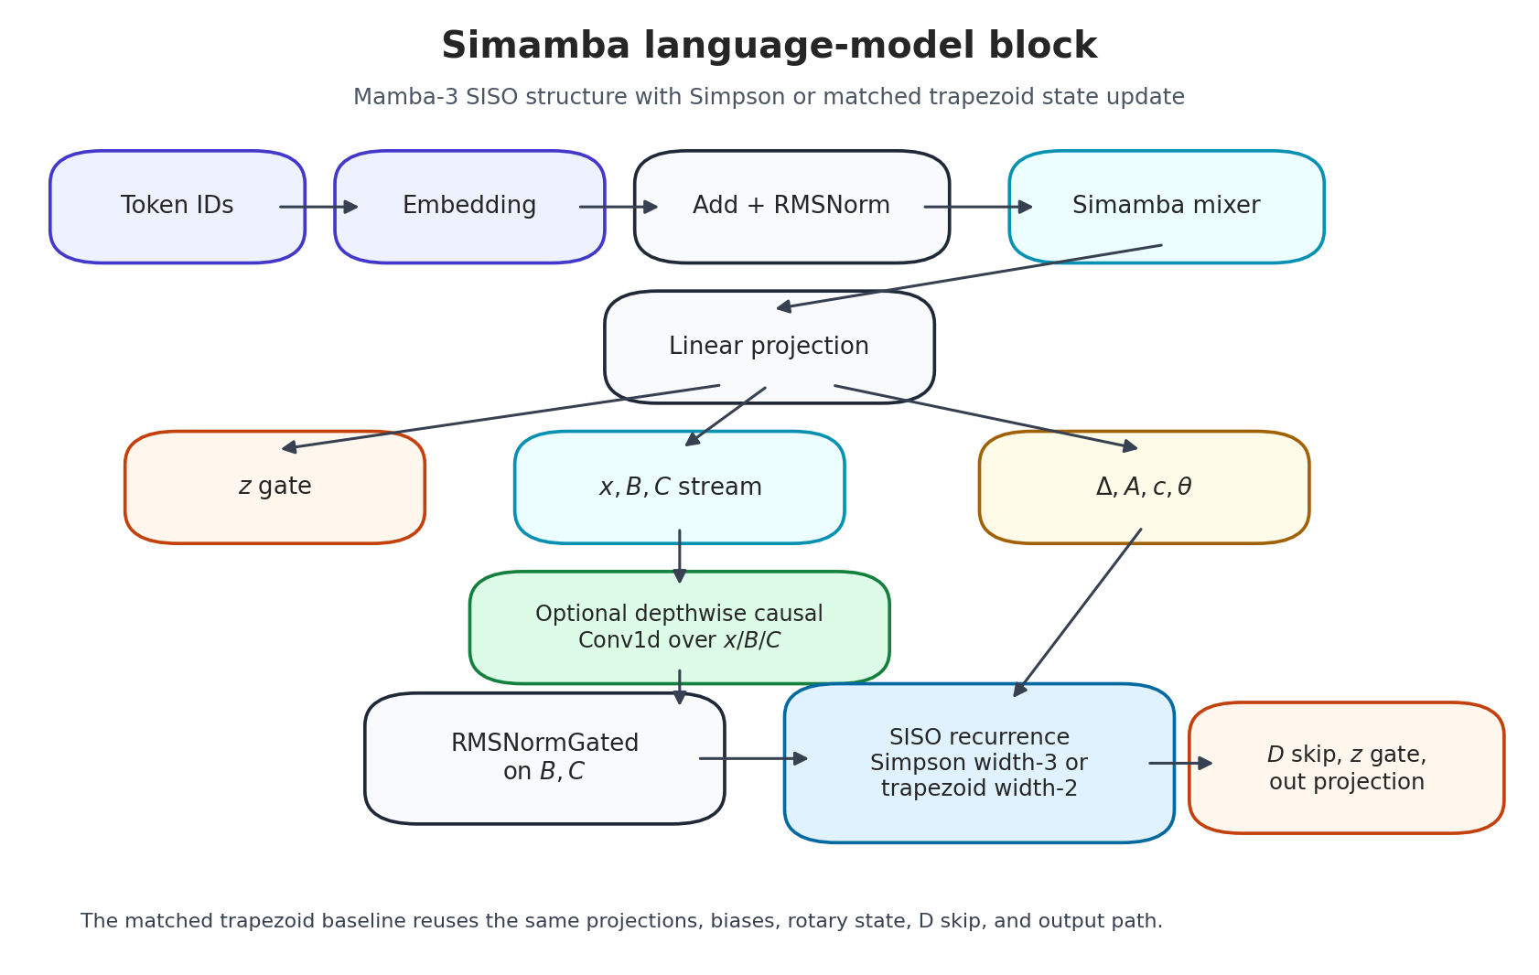
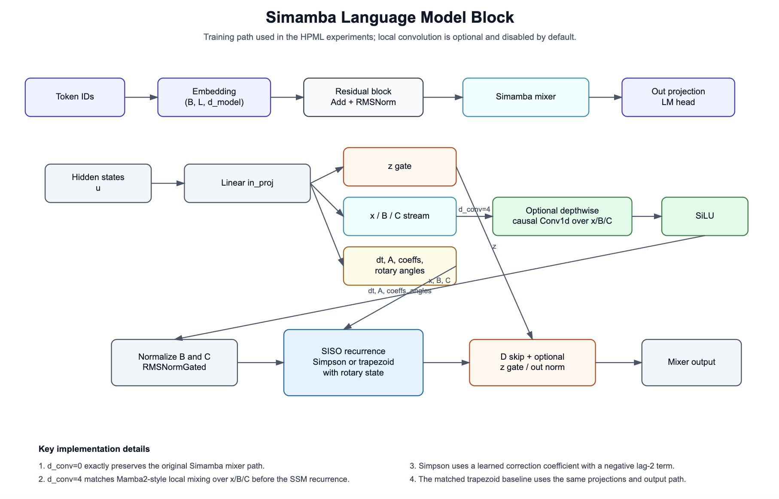
Technical Approach — Architecture
HPML · Spring 2026
3 / 14

Slide 5
Technical Approach — Optimizations Applied
The work became a controlled systems-and-modeling study after the original multi-GPU plan was reduced to one V100.
1.
Simpson-style SISO Dynamics
Width-3 causal recurrence with a learned correction term; tests whether Simpson-like history improves state updates over trapezoid.
2.
Stability + Reproducibility Fixes
fp32 parameters, cosine decay, nonfinite-step checks, checkpoint manifests, fixed validation spans, and no-replacement sampling.
3.
Matched Controls + Export Path
Added trapezoid and local-conv controls, V100 benchmark plots, compression eval, Hugging Face export, and vLLM Transformers-backend serving path.
HPML · Spring 2026
4 / 14

Slide 6
Profiling Methodology
We measured both model quality and system behavior, because the scientific result and deployment result diverged.
Tools
Metrics captured
• scripts/train_simamba_lm.py structured logs
• Weights & Biases local histories
• benchmarks/benchmark_simamba_siso.py
• scripts/generate_hpml_paper_assets.py
• Checkpoint manifests and compression JSONL
• Hugging Face/vLLM export smoke checks
• Fixed validation loss and smoothed train loss
• Pre/post-clip gradient norms and nonfinite skips
• Training tokens/sec on V100
• SISO prefill latency, decode-step latency, throughput
• Peak memory for prefill/decode cases
• Post-training int8/int4/pruning loss deltas
HPML · Spring 2026
5 / 14

Slide 7
Results — Headline Numbers
Headline: the Simpson hypothesis was not validated, but the controls identify why and where the system bottleneck is.
1.08×
25.8%
4.9178
decode-step overhead
lower prefill peak memory
best Simamba val loss
Simamba vs Mamba-3: 0.0173 ms vs 0.0160 ms in B4/P1024/G256
124.2 MB vs 167.4 MB in B4/P1024/G256; latency still dominates
Mamba2 best: 4.8625; matched trapezoid: 4.9326
Measured on one Tesla V100 16GB. Prefill was 410×–777× slower than the Mamba-3 fused path, so fused-kernel work is required before production claims.
HPML · Spring 2026
6 / 14

Slide 8
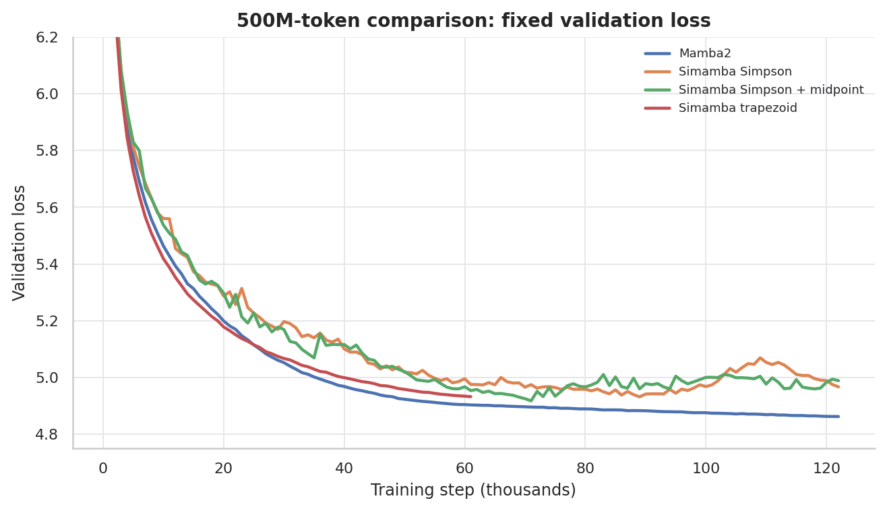
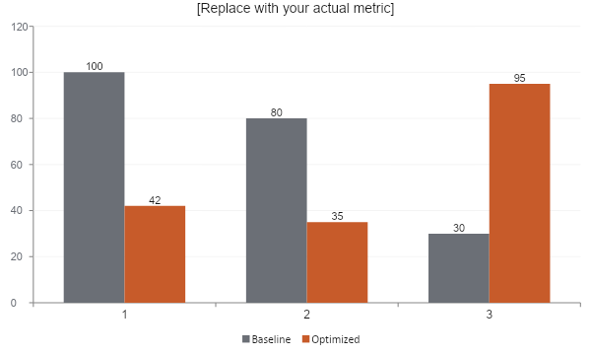
Results — Quality Curves
500M-token comparison from locally persisted W&B/training histories.
Takeaway
Takeaway
• Mamba2 is the strongest overall baseline.
• Simpson+midpoint reaches the best Simamba checkpoint, but validation degrades later.
• Matched trapezoid is competitive, so the Simpson correction is not yet a win.
• Gradient curves point to harder optimization from the negative lag-2 term.
• Mamba2 is the strongest overall baseline.
• Simpson+midpoint reaches the best Simamba checkpoint, but validation degrades later.
• Matched trapezoid is competitive, so the Simpson correction is not yet a win.
• Gradient curves point to harder optimization from the negative lag-2 term.
7 / 14

Slide 9
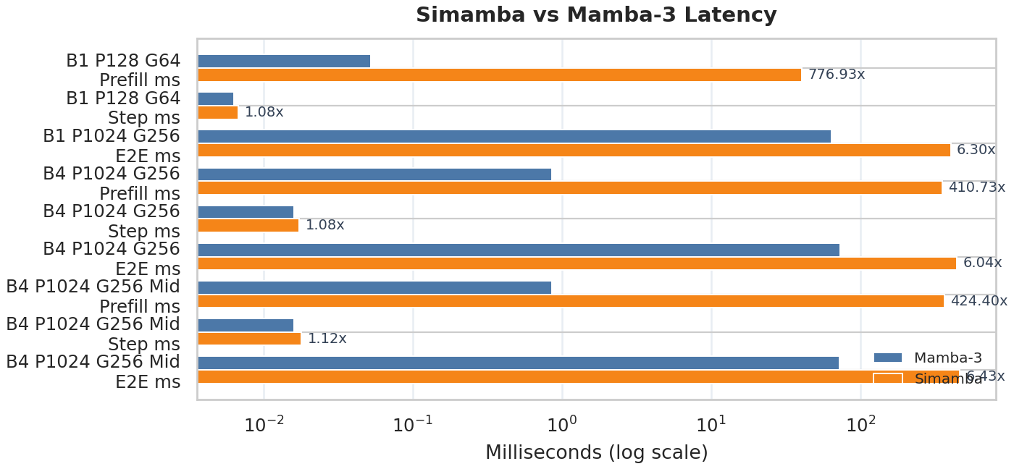
Profiler Evidence — Kernel Bottleneck
Repository SISO benchmark separates prefill from decode; this is where the implementation gap is clearest.
What to point at
• Decode step is close: about 1.08× slower than Mamba-3.
• Prefill is not competitive: 410×–777× slower in benchmark cases.
• Current path still has too much Python/memory traffic; needs a fused prefill kernel.
• Memory can be comparable or lower, but latency is the blocking metric.
HPML · Spring 2026
8 / 14

Slide 10
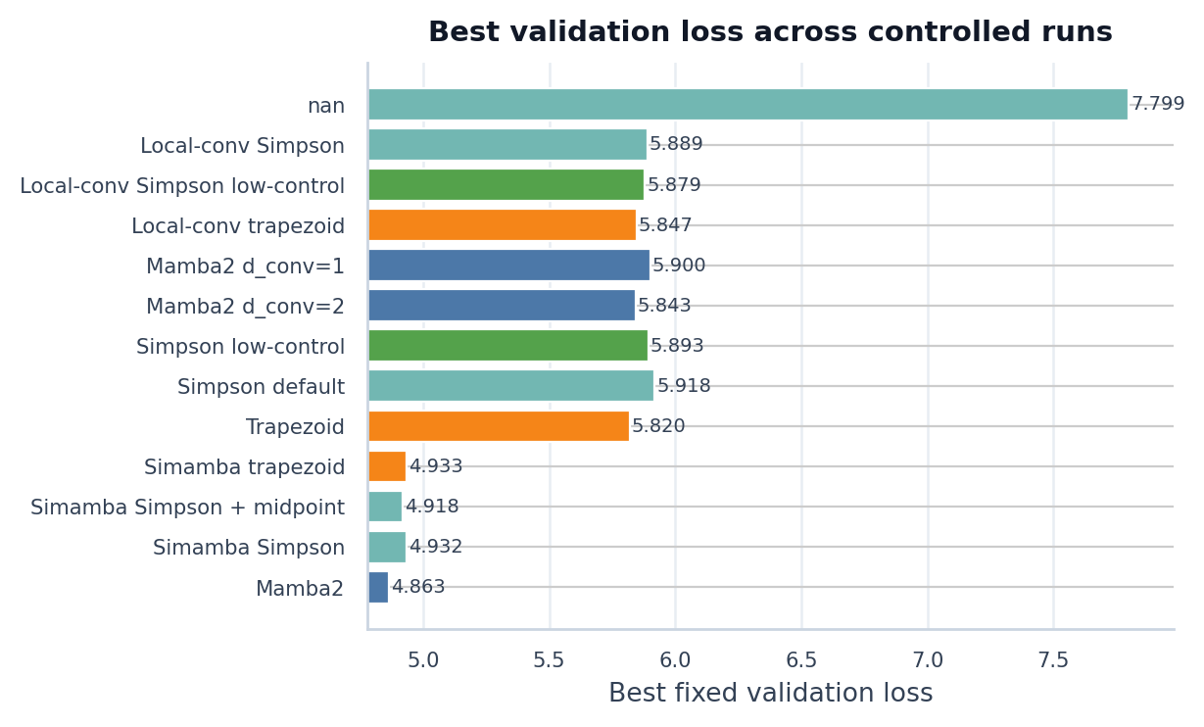
Demo / Visualization — Reproducible Artifacts
For a 1-minute demo, show the exported checkpoints and regenerate the paper figures from local run histories.
Exported models
soumil1/simamba-midpoint-10m-slimpajama-500m soumil1/mamba2-10m-slimpajama-500m
Serving path
vLLM Transformers backend --trust-remote-code --model-impl transformers
Rebuild figures
python scripts/generate_hpml_paper_assets.py
HPML · Spring 2026
9 / 14

Slide 11
Lessons Learned
The most useful outcome is a controlled diagnosis, not a cherry-picked speedup claim.
What worked
What didn't work
• fp32 parameters + cosine decay eliminated nonfinite skips in controlled runs.
• Fixed validation spans made small loss differences interpretable.
• Matched trapezoid/local-conv controls separated discretization from architecture confounds.
• Decode path is close enough to justify more kernel work.
• Unconstrained Simpson lag-2 correction produced noisier gradients and worse final validation.
• Prefill implementation is hundreds of times slower than the Mamba-3 fused path.
• Larger-model attempts were dominated by V100 memory/runtime pressure.
• Local mixing mattered more than the initial Mamba2-vs-Simamba comparison suggested.
HPML · Spring 2026
10 / 14

Slide 12
Next Steps
Concrete follow-ups before scaling beyond 10M parameters.
• Reparameterize or anneal the Simpson correction so the negative lag-2 term cannot dominate early training.
• Build a fused local-conv + SISO prefill kernel; current prefill latency blocks deployment.
• Add a V100-compatible benchmark fallback for kernels requiring newer Triton descriptor APIs.
• Run multi-seed 50M-token comparisons only after a single-seed Simpson variant beats matched trapezoid.
• Explore prefix/state caching as a future memory advantage over Transformer KV caching.
• Add finetuning-aware int4/pruning experiments instead of one-shot perturbations.
HPML · Spring 2026
11 / 14

Slide 13
Teamwork & Contributions
Required contribution summary for Team 26.
Member | Primary contributions | Tools / artifacts
Soumil Baldota ssb2234 | Simamba mixer implementation, training loop hardening, checkpoint/export flow, paper asset generation. | mamba_ssm/modules/simamba.py scripts/train_simamba_lm.py scripts/generate_hpml_paper_assets.py
Ansen Shia as8008 | Controlled ablation plan, data preparation, validation protocol, W&B run tracking, result interpretation. | prepare_slimpajama.py run_logs/* docs/assets/paper/*
David Zhang dwz2107 | Benchmark/profiling analysis, compression experiments, systems diagnosis, report/presentation synthesis. | benchmarks/* eval_checkpoint_compression.py docs/paper.tex
All | Weekly coordination, experiment triage, negative-result review, final report and presentation edits. | GitHub + W&B + shared docs
Collaboration: recurring working sessions around V100 runs, W&B dashboards, checkpoint handoffs, and paper/deck reviews. The final story was aligned around a reproducible negative result and the systems bottleneck it exposed.
HPML · Spring 2026
12 / 14

Slide 14
Thank you
Questions?
GitHub: github.com/hpmls26/simamba
Tracking: Weights & Biases project ssb2234-columbia/simamba
Checkpoints: soumil1/simamba-midpoint-10m-slimpajama-500m · soumil1/mamba2-10m-slimpajama-500m
HPML · Spring 2026
13 / 14

Slide 15
Backup — Experimental Setup
Configuration used for the controlled language-model comparisons.
Setting | Baseline/control | Simamba runs
Model family | Mamba2 or matched Simamba trapezoid | Simamba Simpson / Simpson+midpoint
Shape | 8 layers, d_model=160, d_state=64 | same; d_inner=320, 10 heads, headdim=32
Training data | SlimPajama 500M train / 50M val | same tokenized memmaps and fixed val spans
Batch / sequence | global batch 64, micro-batch 8, seq_len 128 | same
Optimizer | AdamW, weight decay 0.1, cosine decay | same; fp32 master params
Hardware | single Tesla V100-SXM2 16GB | same
Evaluation | best/final val loss, train throughput, grad norms | plus SISO benchmark and compression perturbations
HPML · Spring 2026
14 / 14

